Slide 1
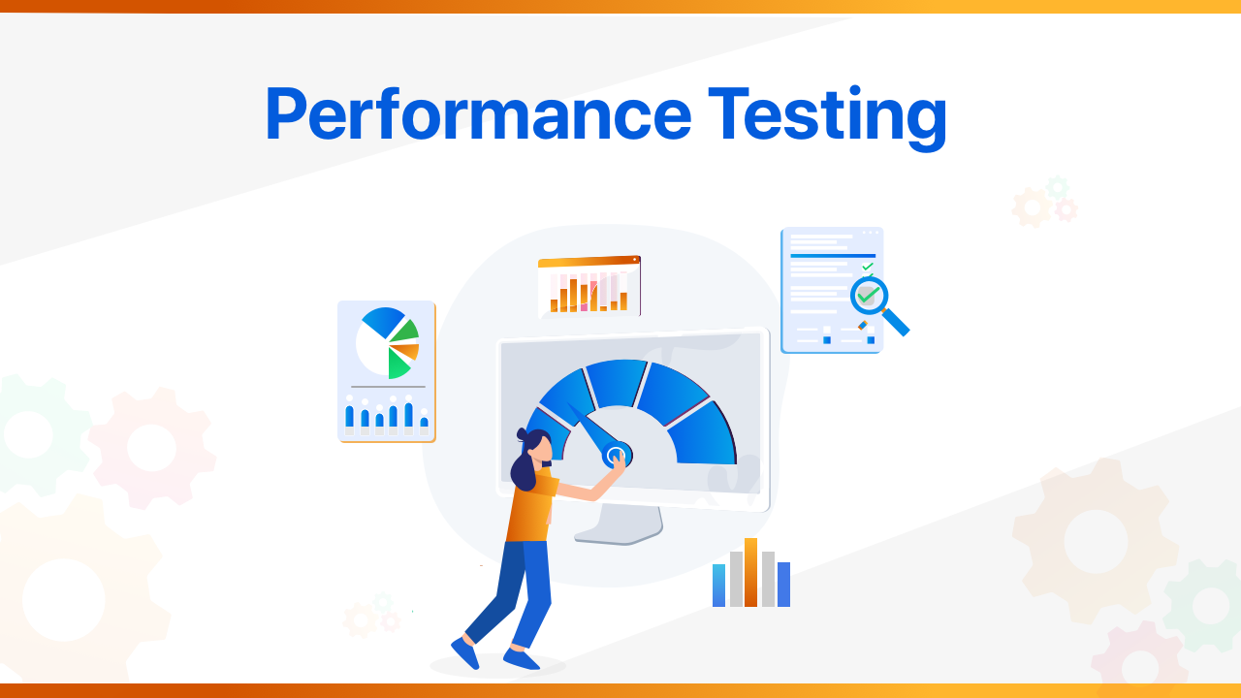

Slide 2
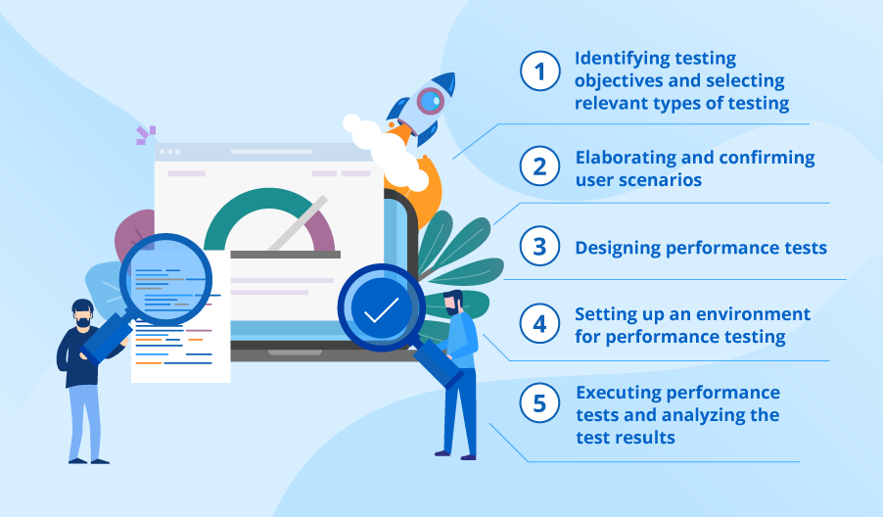
What is Performance Testing?
Why Use Performance Testing?
Types of Performance Testing.
Performance Testing Process.
Performance Testing Tools.
6
Some Screenshots From My Demo.

Slide 3

What is Performance Testing?
It is a non-functional testing technique used for testing the speed, response time, stability, reliability, scalability and resource usage of a software application under particular workload. The main purpose of performance testing is to identify and eliminate the performance bottlenecks in the software application.

Slide 4
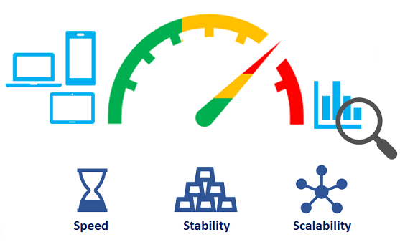
Why Use Performance Testing?
Performance Testing is done to provide stakeholders with information about their application regarding speed, stability, and scalability. More importantly, Performance Testing uncovers what needs to be improved before the product goes to market. Without Performance Testing, software is likely to suffer from issues such as: running slow while several users use it simultaneously, inconsistencies across different operating systems and poor usability.
Also, mission-critical applications like space launch programs or life-saving medical equipment should be performance tested to ensure that they run for a long period without deviations.

Slide 5
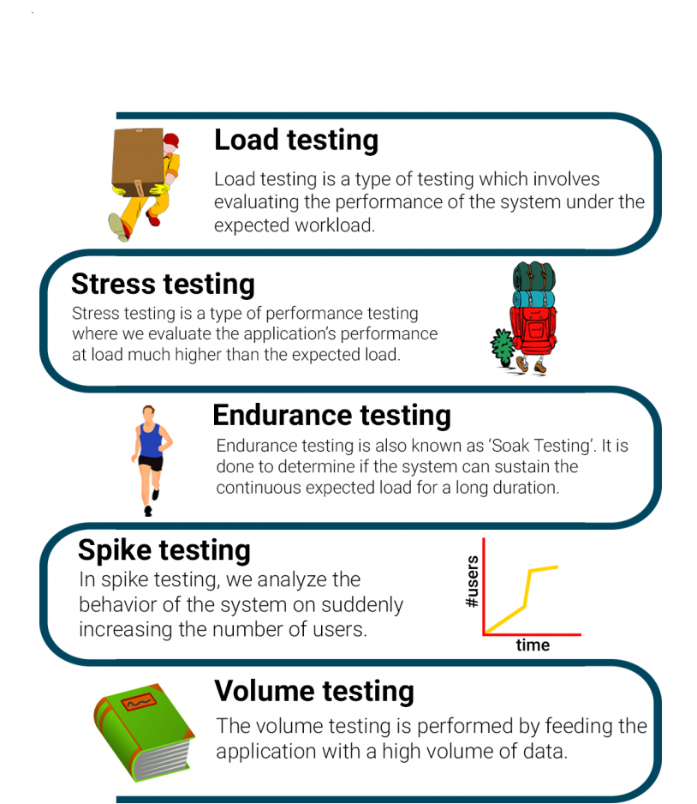
Types of Performance Testing:

Slide 6
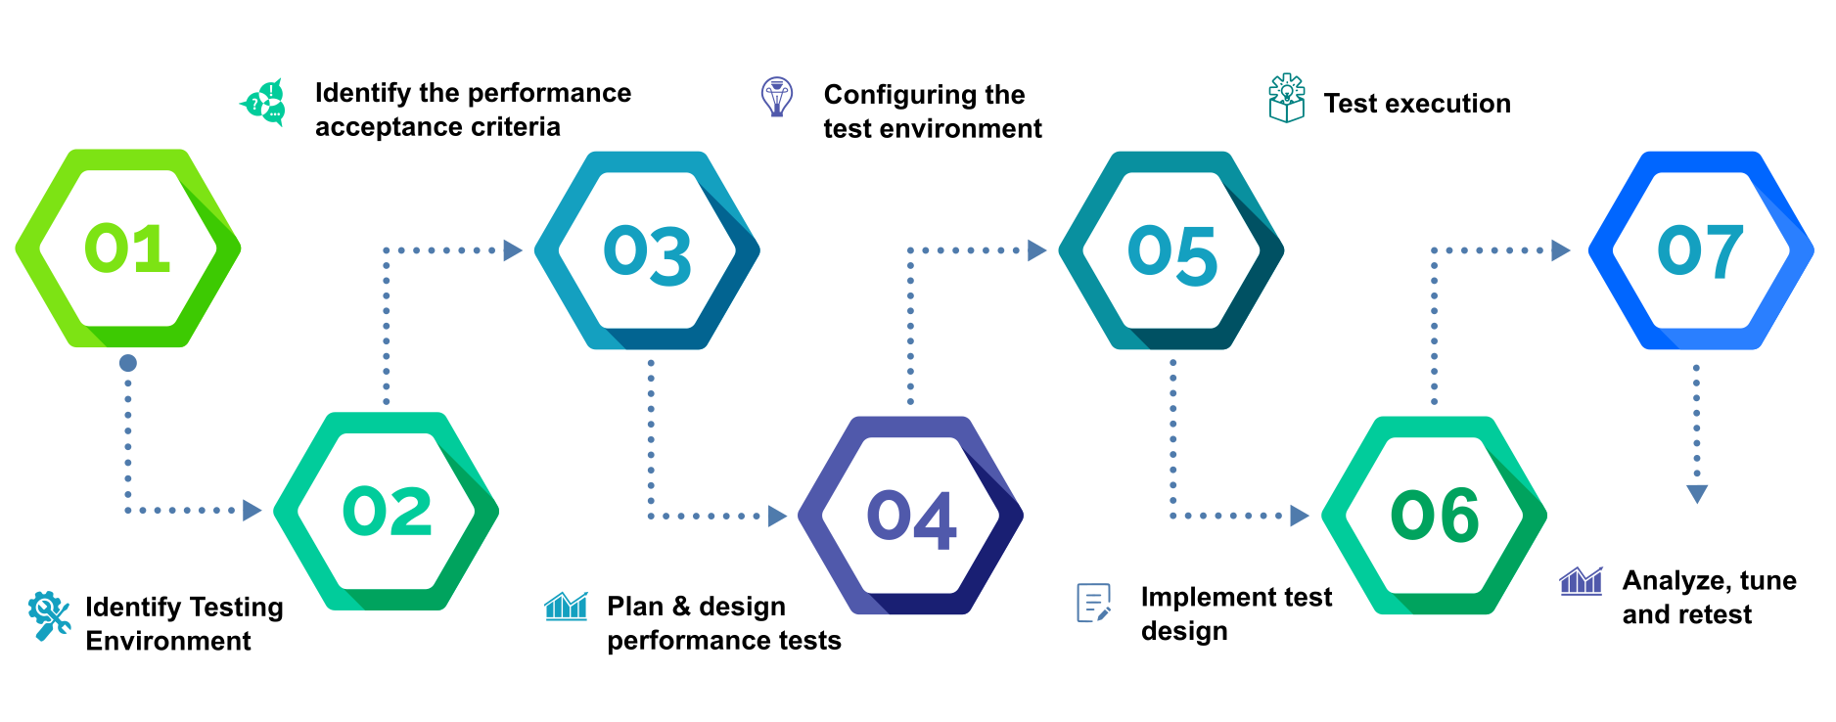
Performance Testing Process:

Slide 7





Performance Testing Tools:

Slide 8
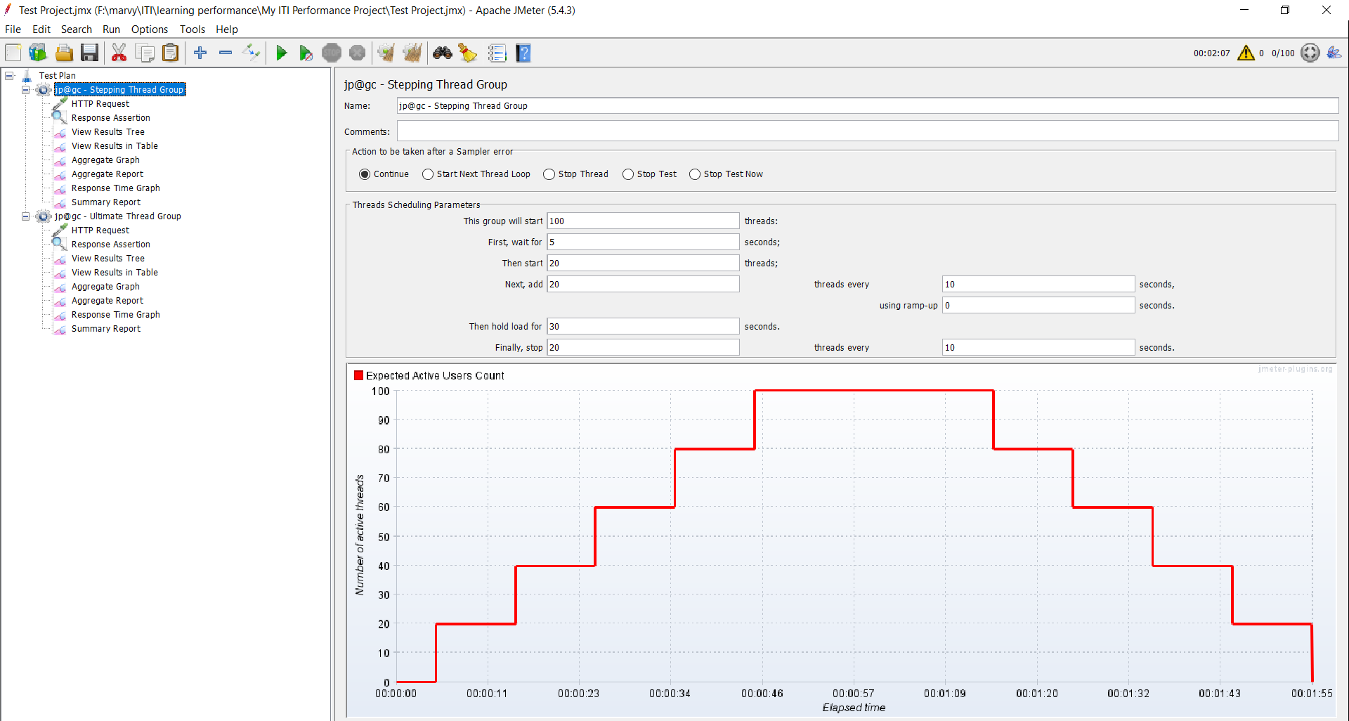
Some Screenshots From My Demo:
Load Performance Testing

Slide 9
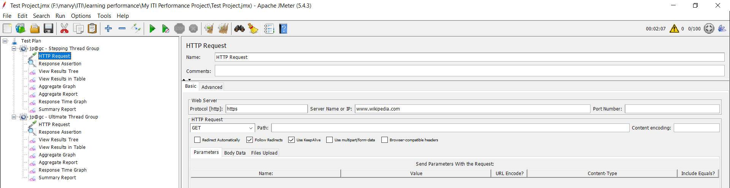
HTTP Request

Slide 10
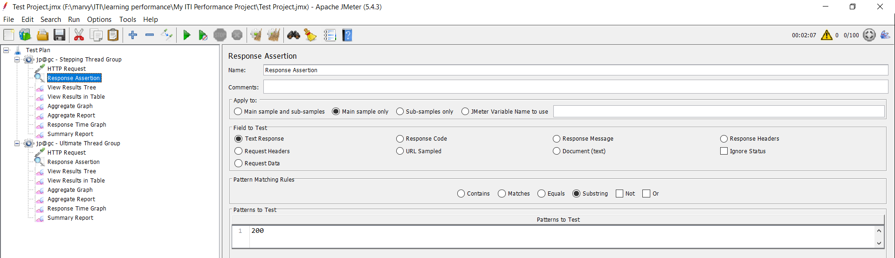
Response Assertion

Slide 11
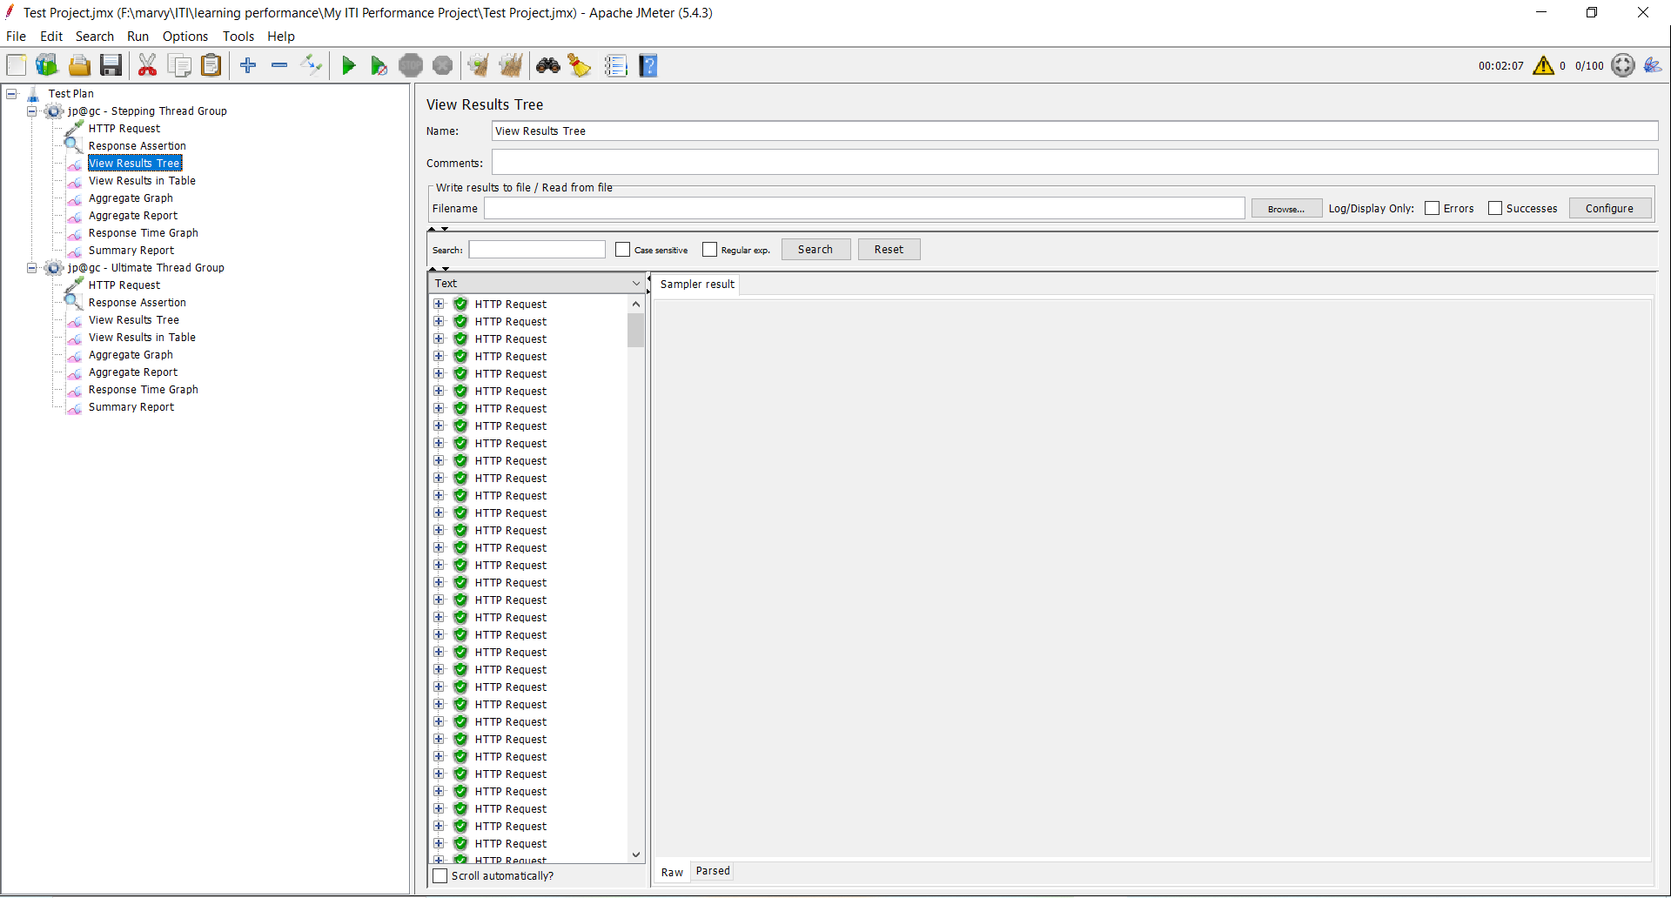
View Result Tree

Slide 12
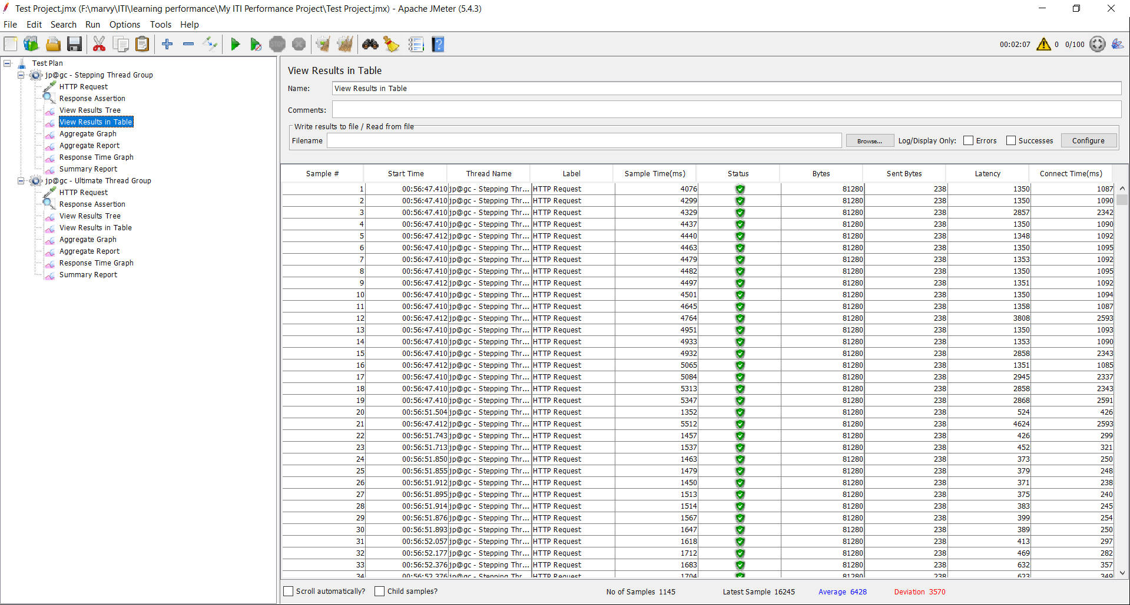
View Result in Table

Slide 13
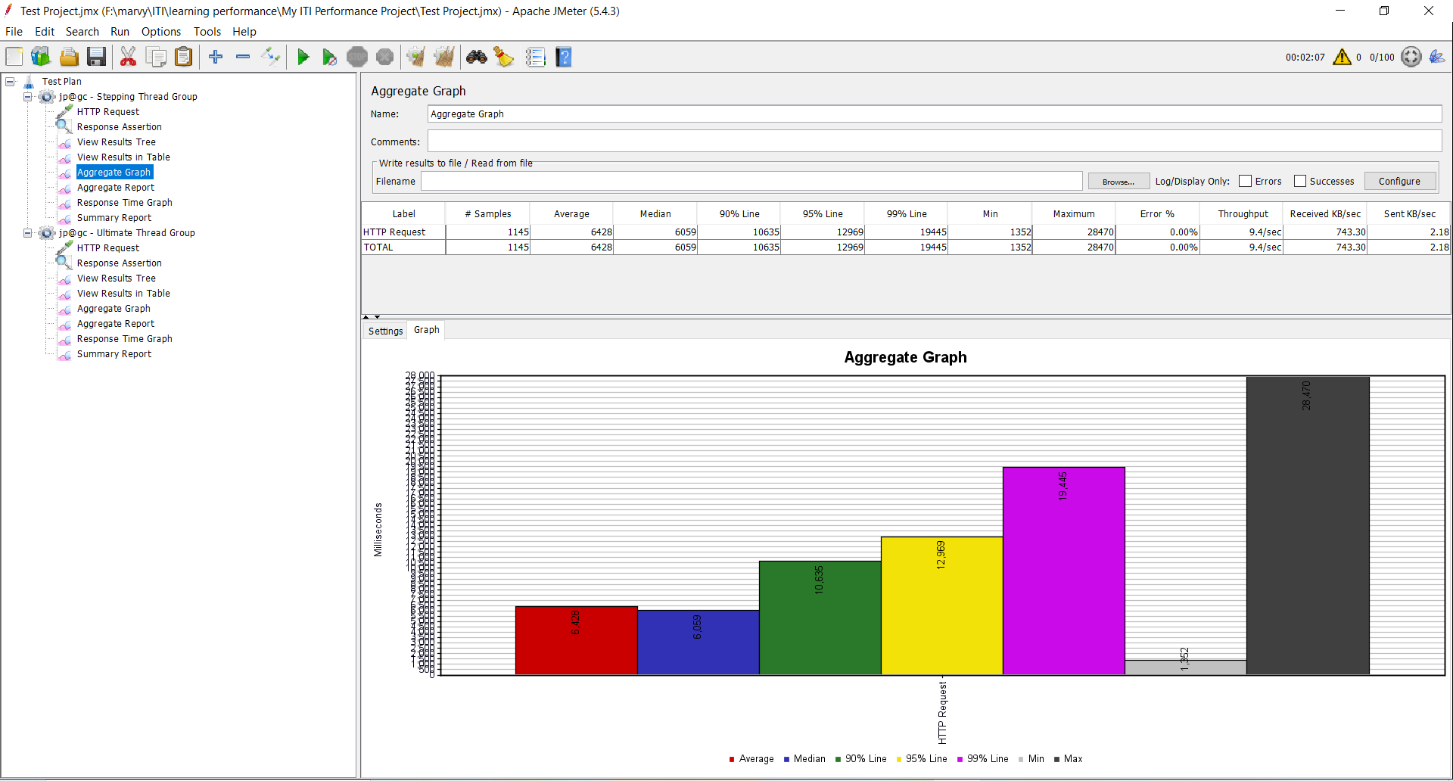
Aggregate Graph

Slide 14
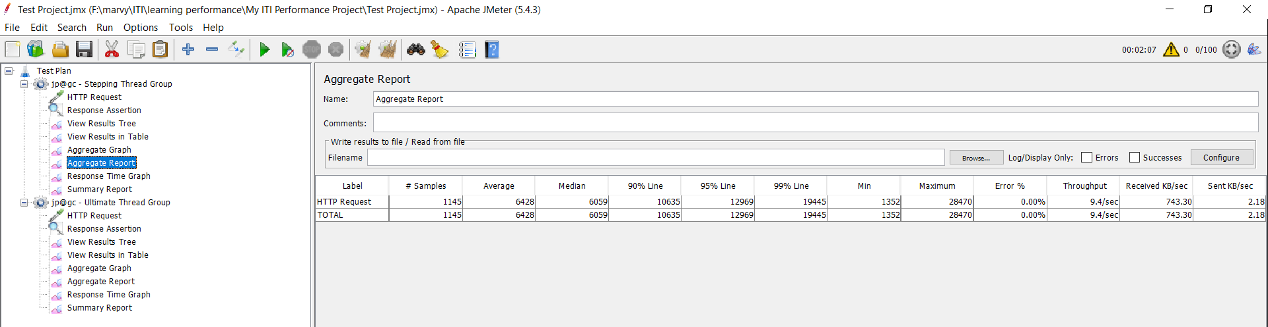
Aggregate Report

Slide 15
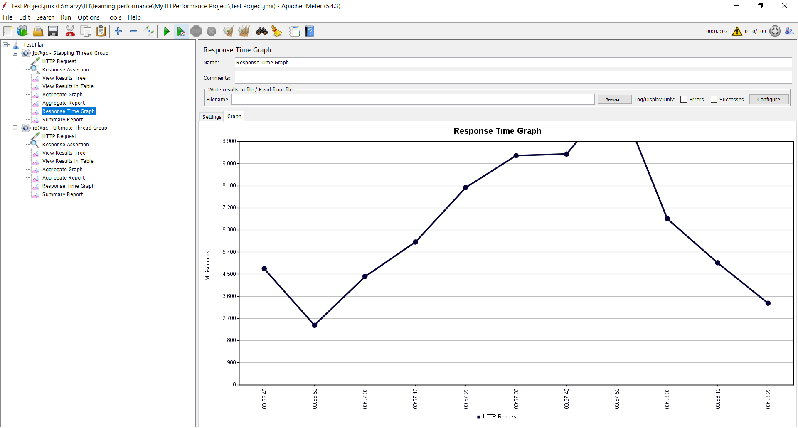
Response Time Graph

Slide 16
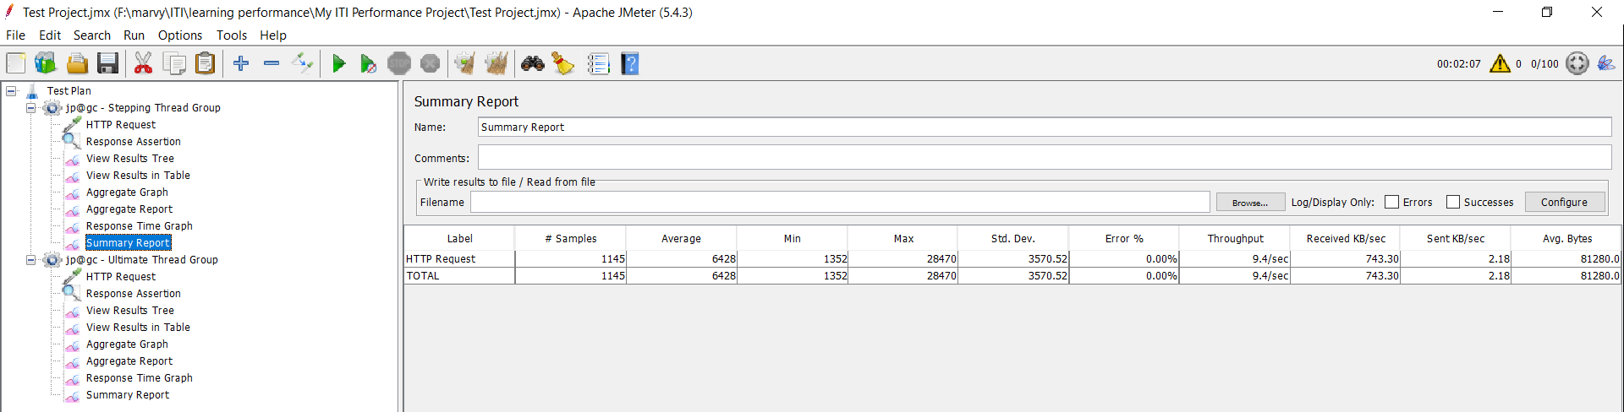
Summary Report

Slide 17
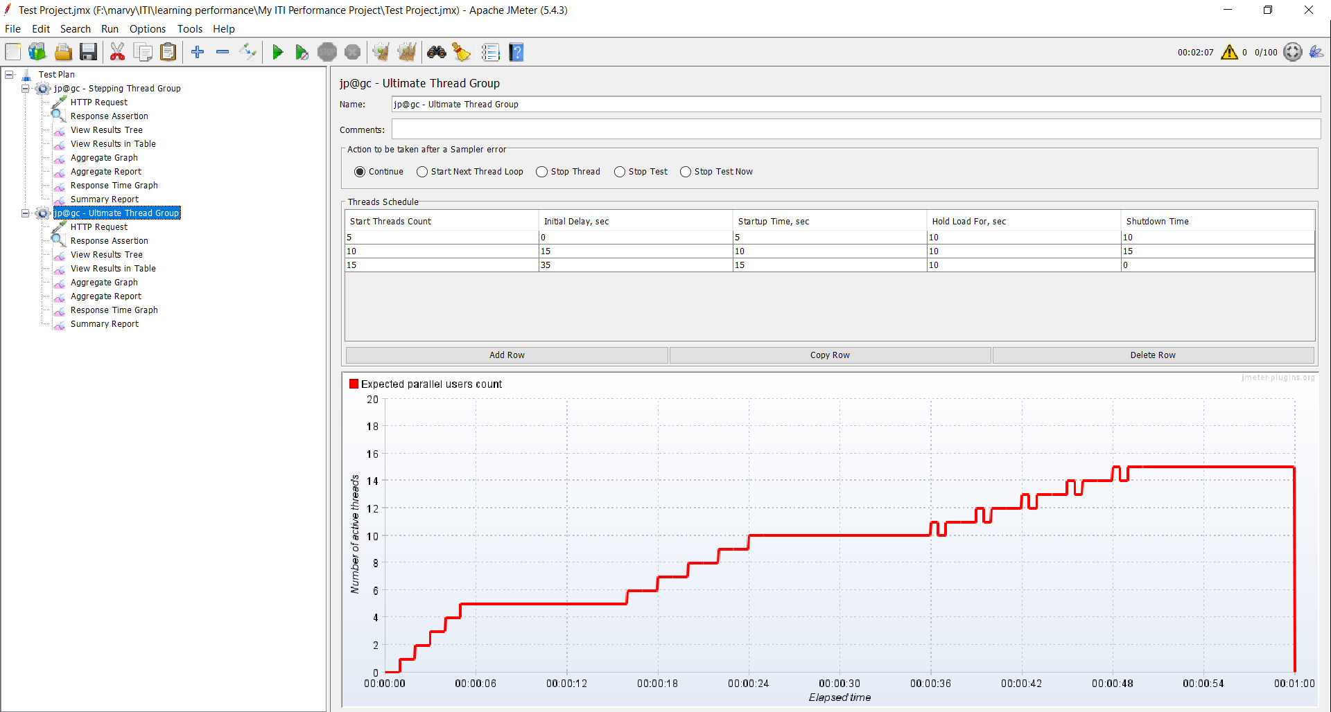
Spike Performance Testing

Slide 18


